Slide 1
Chapter 1:
Object-Oriented Programming and Java
Data Structures in Java: From Abstract Data Types to the Java Collections Framework
by Simon Gray

Slide 2
Abstraction (revisited)
A tool to manage complexity; highlight the interface to a “thing” while hiding its implementation details
Applied to data types ⇒ Abstract Data Type
  The specification view of a type: no implementation details, just values and behavior

Slide 3
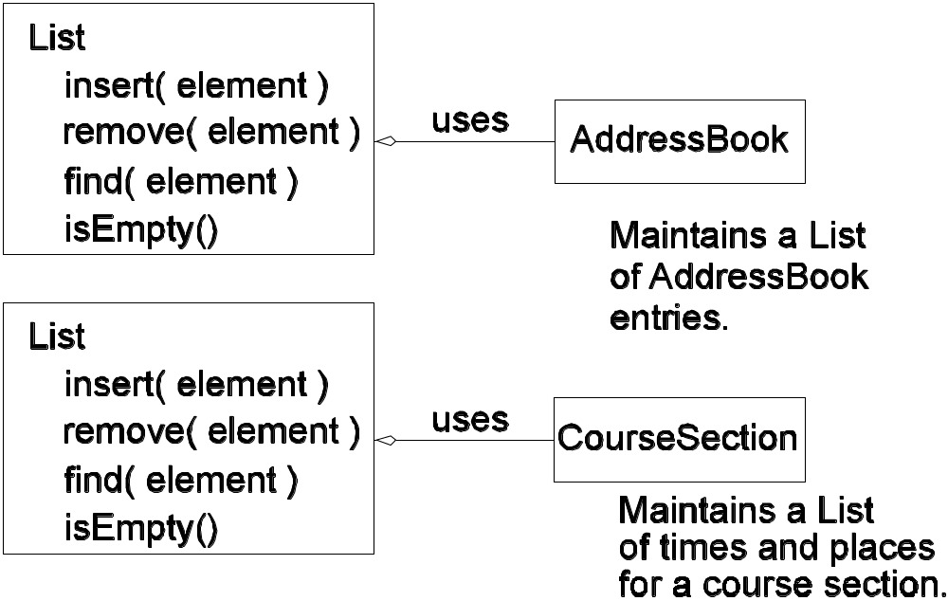
Abstraction: Collection Example
A List has many uses. A client (user) accesses a List through its public interface (API) without any knowledge of how the List is implemented.

Slide 4
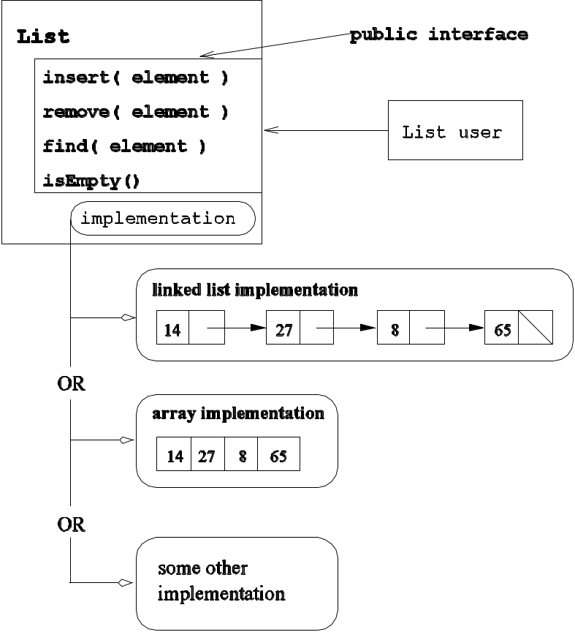
Abstraction: Collection Example
What does a user of a List
need to know about it? Its
behavior as described in its
API and related documentation.
Possible implementations of the List ADT. The implementation details are hidden from the user of the List, who relies on the List’s public interface.

Slide 5
Specifying an ADT
ADT name
ADT description A brief description of the new type.
ADT invariants Characteristics that must always be true of an instance of this type.
ADT attributes Represent the state of an instance of the ADT.
ADT operations Define the behavior of the ADT and the interface available to clients.
Include the following for each operation:
operation: The purpose of the operation – its intended semantics.
pre-conditions: The conditions assumed to be true on entry to the operation if the operation is to execute successfully. This may include assumptions about the state of the object on entry, assumptions about the parameters passed in, and so on.
post-conditions: What the operation guarantees to be true on exit and how the operation changed the state of the object. On exit from the operation, no change to the object’s state may violate any of the ADT’s invariants.
returns: The type of value, if any, returned by the operation.
exceptions: A description of the exceptions an operation may generate and the circumstances.

Slide 6
Partial Specification of the Rectangle ADT
_{Description}
A rectangle is a four-sided shape in which opposite sides are parallel and equal in size. The length of a side must be greater than 0. A rectangle has four right angles.
_{Invariants}
1. Opposite sides are of equal size.
2. Length and height must be greater than 0.
_{Attributes}
DEFAULT_SIZE a constant, the default size for the dimensions
length size of the “top” and “bottom” sides
height size of the “left” and “right” sides
surface area the surface area of the rectangle
perimeter the perimeter of this rectangle

Slide 7
Partial Specification of the Rectangle ADT
_{Operations}
_{constructor()}
_{pre-condition: none}
responsibilities: default constructor—creates a rectangle with length and height set to DEFAULT_SIZE
post-condition: the rectangle is initialized to the default values
_{returns: nothing}
_{constructor( length, height )}
_{pre-condition: none}
responsibilities creates a rectangle with length length and height height; if a dimension is invalid, the default size is used
post-condition: the rectangle is initialized to client-supplied values, if valid, or the default values otherwise
_{returns: nothing}

Slide 8
Partial Specification of the Rectangle ADT
_{getLength()}
_{pre-condition: none}
responsibilities returns this rectangle’s length
post-condition: the rectangle is unchanged
returns: the length of the rectangle
_{setLength( newLength )}
_{pre-condition: none}
responsibilities resets length to newLength if newLength is valid; otherwise does nothing
post-condition: rectangle’s length field is updated if newLength is valid
_{returns: nothing}
_{getSurfaceArea()}
_{pre-condition: none}
operation: compute the surface area of this rectangle
post-condition: the rectangle is unchanged
returns: the surface area of the rectangle

Slide 9
Checkpoint
The Rectangle ADT is not fully specified. Using the format shown in Table 1.1, add descriptions to Rectangle for the following:
  an accessor operation to get the Rectangle’s perimeter.
  a mutator operation to set the height of the Rectangle.

Slide 10
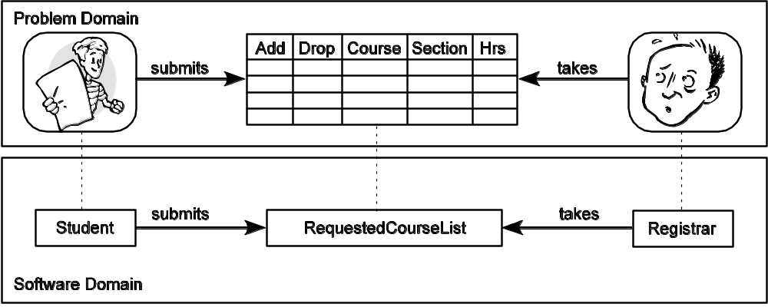
Object-Oriented Programming
Objects model entities from the problem domain.
Objects communicate with each other by sending messages.
The kinds of message an object can receive describe its behavior.

Slide 11
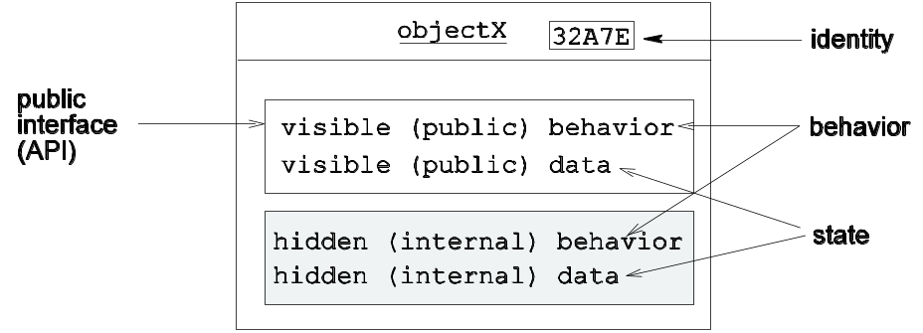
Characteristics of an Object
State – the values stored in an object’s attributes
  Stable state: the values of the attributes are consistent with the class’s invariants
• Behavior – the set of operations visible in the object’s API; defines the kinds of messages the object can receive
  Constructor – put the object in an initial stable state
  Accessor – retrieve state information; may be synthesized
  Mutator – change the state of the object (consistent with the invariants)
• Identity – unique for each object

Slide 12
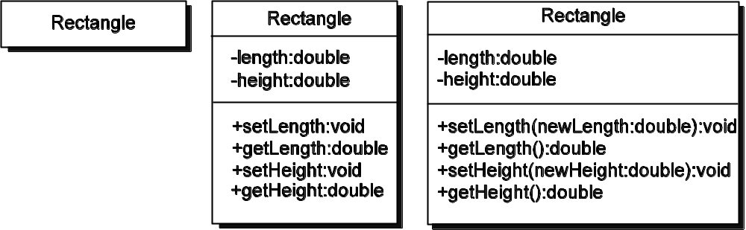
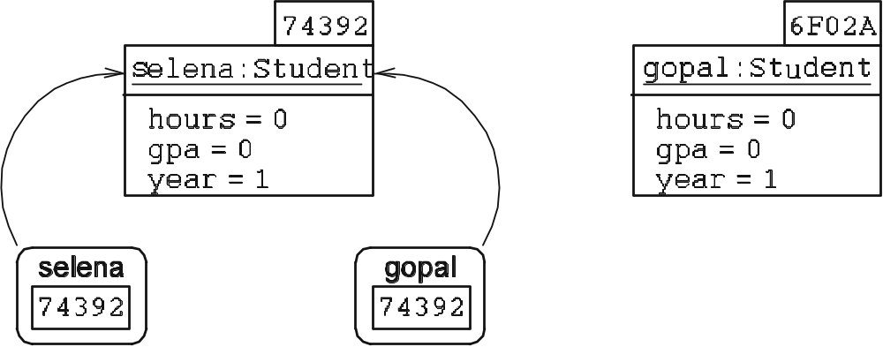
UML: Class and Object Diagrams
UML class diagrams
Notation | Visibility
+ | public
# | protected
- | private
UML object diagrams

Slide 13
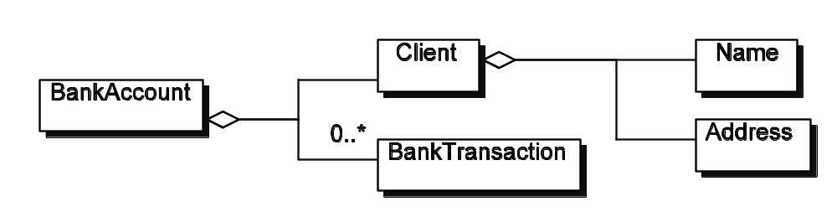
Code Reuse: Composition (revisited)
Composition: Where is the code reuse?
A class is composed of one or more other classes.
0 or more instances of
UML leaves open how you represent
a collection of things. Here we chose
a List.
public class BankAccount {
private Client client;
private List<BankTransaction> transactions;
// other fields
...
}

Slide 14
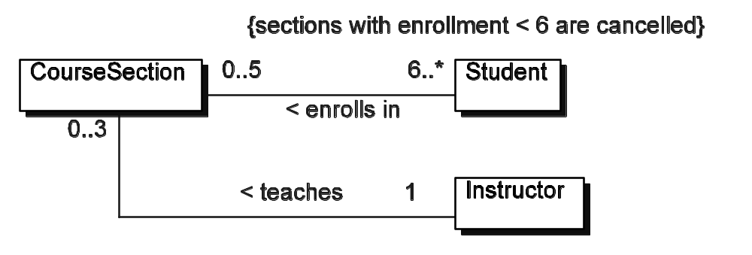
Code Reuse: Composition (revisited)
UML adornment
_{public class Student {}
private CourseSection[] courseSchedule;
// other data and method fields ...
}
_{public class CourseSection {}
private Student[] sectionRoster;
_{private Instructor instructor;}
// other data and method fields ...
}
_{public class Instructor {}
private CourseSection[] sectionsTaught;
// other data and method fields ...
}
A CourseSection must
have 1 Instructor
Here the programmer chose to use
an array as the “collection” type.

Slide 15
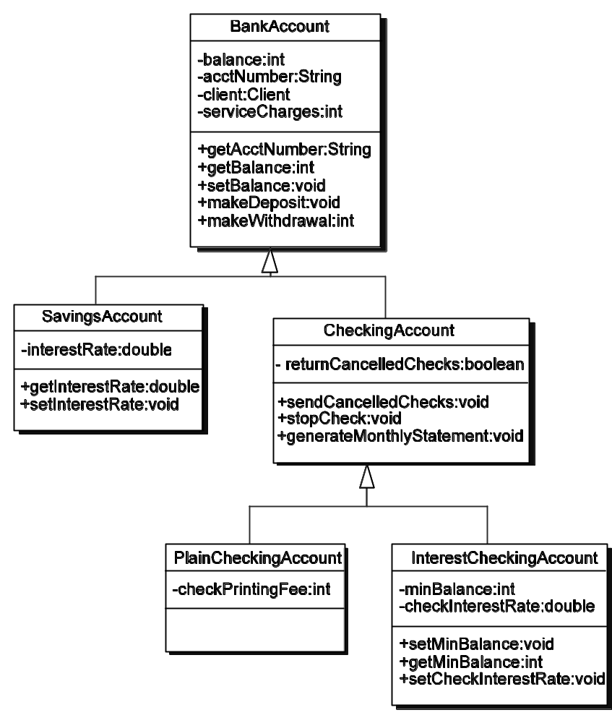
Code Reuse: Inheritance (revisited)
Inheritance: Where is the code reuse?
A class inherits attributes and behavior
from its parent (which inherits from its
parent, and so on).
public class CheckingAccount extends BankAccount {
// class body goes here
}
public class InterestCheckingAccount
extends CheckingAccount {
// class body goes here
}

Slide 16
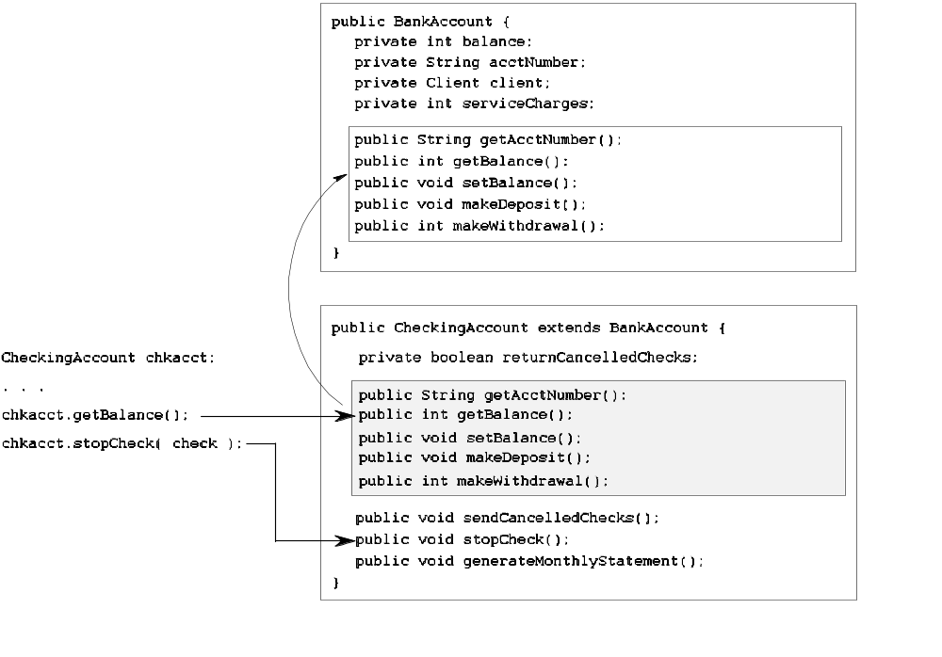
Code Reuse: Inheritance (revisited)
A CheckingAccount object
can provide public access to all
the public fields it inherits from
BankAccount.

Slide 17
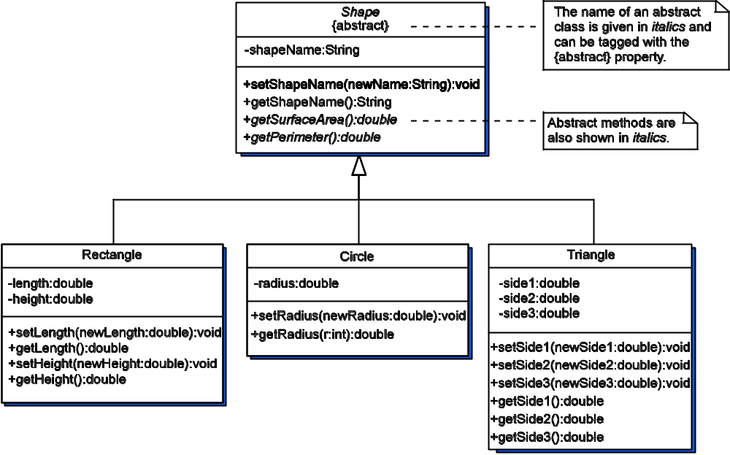
Another inheritance hierarchy
What does Circle inherit
from Shape?
If r1 is a reference to a
Rectangle, what messages
can I send it?

Slide 18
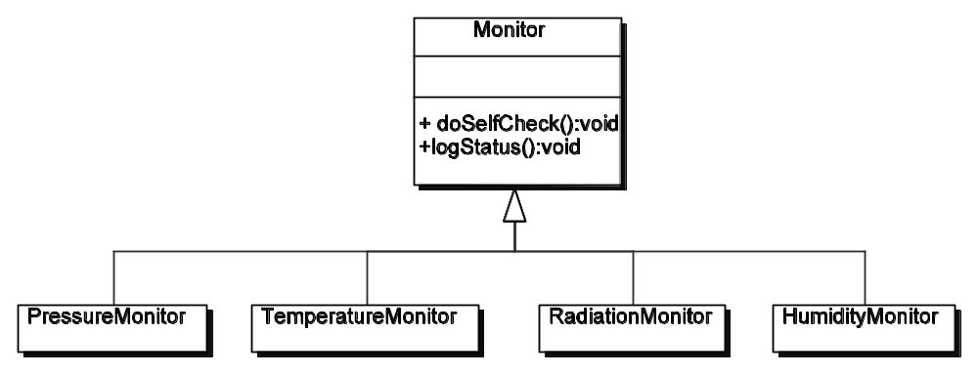
Polymorphism: a form of code reuse
1 // create N monitor references
2 Monitor [] monitor = new Monitor[ N ];
₃
4 // populate array with Monitor instances
5 monitor[0] = new PressureMonitor();
6 monitor[1] = new TemperatureMonitor();
7 monitor[2] = new RadiationMonitor();
8 monitor[3] = new HumidityMonitor();
_{9 // and so on...}
₁₀
11 // now have each one do a regular checkup
12 for ( i = 0; i < monitor.length; i++ ) {
13 monitor[i].doSelfCheck();
14 monitor[i].logStatus();
_{15 }}
Polymorphism: Allow a block of code to be used with different types of data
Substitution principle: we can
Substitute instances of a subclass for
an instance of its superclass
Dynamic binding: the runtime system will bind an object reference to a specific object at the time of the method call
Monitor[i] is bound to a specific type (e.g., PressureMonitor, HumidityMonitor) at runtime, ensuring that the correct version of the methods is invoked.

Slide 19
A Shapes Hierarchy
Let’s start with an ADT description and see how to map it to a class definition.
ADT Shape
Description
A shape object represents a geometric shape. Every shape has a name (the kind of shape it is), a surface area, and a perimeter. Surface area and perimeter are determined by characteristics particular to a kind of shape. An object created to be one kind of shape cannot become another kind of shape. The dimensions of a shape must be greater than 0.
Invariants
1. Every shape has a name. The default name is “Unknown.”
2. The dimensions of a shape must be greater than 0. The default size for a dimension is 1.0.

Slide 20
Shape: Mapping attributes to data fields
ADT Shape
Class variables
  DEFAULT_SIZE a constant, the default size for a shape is 1.0
  DEFAULT_NAME String the default shape name is “Unknown”
Instance variables
  shapeName String the name of this type of shape
ADT
An abstract class cannot be instantiated
because it is not complete
Declarations
public abstract class Shape {
/**
* The default size used in constructing a shape.
*/
protected static final double DEFAULT_SIZE = (double) 1.0;
protected static final String DEFAULT_NAME = "Unknown";
private String shapeName;

Slide 21
Shape: mapping operations to methods
constructor()
pre-condition: none
responsibilities: default constructor - initialize shapeName to DEFAULT_NAME
post-condition: the shape is initialized
returns: nothing
/**
* Construct a generic instance
* of unknown shape type.
*/
public Shape() {
this.shapeName = DEFAULT_NAME;
}

Slide 22
Shape: mapping operations to methods
setShapeName( String newName )
pre-condition: newName is not null or empty
responsibilities: reset shapeName to newName, if newName is valid, otherwise make no change
post-condition: this shape’s name is set to newName, if valid
returns: nothing
/**
* Reset the shape name for
* this <tt>Shape</tt>.
* @param name the name of this
* kind of shape
*/
protected void setShapeName(
String newNname ) {
if ( newNameame.trim().length()
== 0 )
shapeName = DEFAULT_NAME;
else
shapeName =
new String(newName);
}
Any comments about this?

Slide 23
Shape: mapping operations to methods
constructor( String name )
pre-condition: name is not null or empty
responsibilities: initialize shapeName to name, if name is valid, otherwise use
DEFAULT_NAME
post-condition: the shape is initialized
returns: nothing
/**
* Construct a <tt>Shape</tt>
* whose type is specified in
* the argument.
* @param name the name of this
* kind of shape
*/
public Shape( String name ){
setShapeName( name );
}
Encapsulate the work to be done within
method setShapeName() and reuse it

Slide 24
Shape: abstract methods
/**
* Get the surface area of this <tt>Shape</tt>.
* @return the surface area of this <tt>Shape</tt>
*/
public abstract double getSurfaceArea();
/**
* Get the perimeter of this <tt>Shape</tt>.
* @return the perimeter of this <tt>Shape</tt>
*/
public abstract double getPerimeter();
An abstract method is tagged as abstract and cannot have an implementation. It is here to force compliance in the interface of implementing subclasses. That is, all subclasses will have the same API, even if their implementations are different.

Slide 25
Rectangle: subclassing and code reuse
public class Rectangle extends Shape {
private double length;
private double height;
/**
* Construct a <tt>Rectangle</tt> object
* using the default size for its dimensions.
*/
public Rectangle() {
super("Rectangle");
setLength( super.DEFAULT_SIZE );
setHeight( Shape.DEFAULT_SIZE );
}
. . . // other class stuff
}
A Rectangle “is a kind of” Shape. Use “extends” to have one class extend another class.
Invoke superclass constructor.
Must be first thing done in the constructor.
Reuse existing methods to
do common work

Slide 26
Rectangle: concrete classes
Rectangle provides implementations of the two abstract methods inherited from Shape. Since Rectangle is not declared abstract and implements all inherited abstract methods, it is concrete and can be instantiated.
/**
* Get the surface area of this <tt>Rectangle</tt>.
* @return the surface area of this <tt>Rectangle</tt>;
*/
public double getSurfaceArea() {
return this.length * this.height;
}
/**
* Get the perimeter of this <tt>Rectangle</tt>.
* @return the perimeter of this <tt>Rectangle</tt>;
*/
public double getPerimeter() {
return 2 * this.length + 2 * this.height;
}
Declared abstract in
class Shape

Slide 27
Method Overriding
Implemented methods inherited from an ancestor may not be what the subclass needs.
Example: Object
  All Java classes have Object as an ancestor; it is at the root of the Java inheritance hierarchy
  Two methods inherited from Object are toString() and equals(). The implementation provided by Object is usually not what a subclass needs.

Slide 28
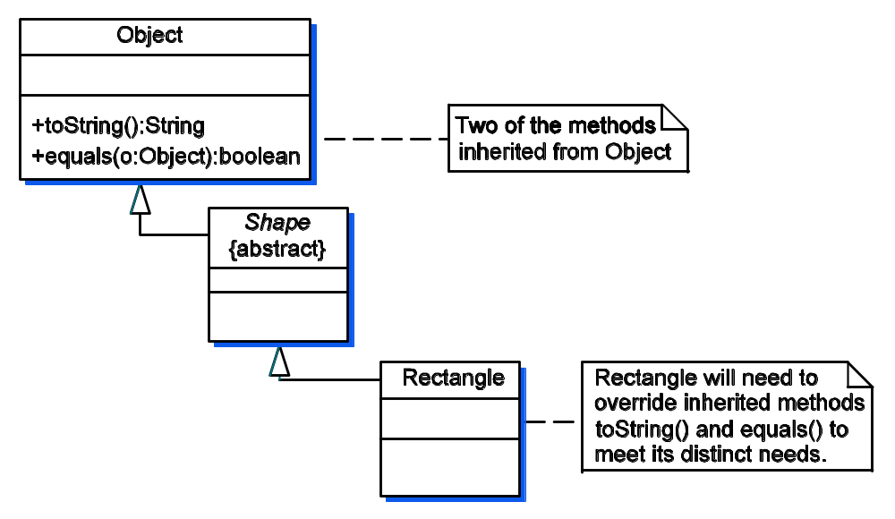
Rectangle in the inheritance hierarchy rooted at Object
An overridden method is one that is inherited and needs a different implementation in the subclass. The method in the subclass must have the same return type and signature as the overridden method from the ancestor.

Slide 29
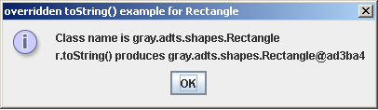
Method Overriding: toString()
package shapeExamples;
import gray.adts.shapes.*;
import javax.swing.JOptionPane;
/**
* Illustrate the use of the inherited toString() method.
*/
public class ShapeEx2 {
public static void main ( String [] args ) {
Rectangle r = new Rectangle();
String output;
// use methods defined in Rectangle and Circle
r.setLength( 4 );
r.setHeight( 5 );
output = "Class name is " + r.getClass().getName() + "\n";
output += "r.toString() produces " + r.toString() + "\n";
JOptionPane.showMessageDialog( null, output,
"overridden toString() example for Rectangle",
JOptionPane.INFORMATION_MESSAGE );
System.exit( 0 );
}
}
_{The toString() method as}
_{inherited from Object only}
_{knows about an object’s type}
_{and identity.}

Slide 30
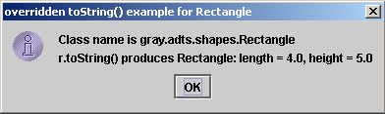
Rectangle: Overridden toString()
Output produced using the overridden toString()
method provided to Rectangle and the code from
Listing 1.6.
/**
* Returns a <tt>String</tt> object representing this
* <tt>Rectangle</tt>‘s value.
* Overridden from <tt>Object</tt>.
* @return a string representation of this object
*/
public String toString() {
return this.getShapeName() + ": this.length = " +
length + " height = " + this.height;
}
The toString() method as overridden in Rectangle.

Slide 31
3D Shapes and Interfaces
A Java class can extend only one other class
A Java class can implement one or more interfaces
A Java interface is like an abstract class in which all methods are labeled abstract. That is, no method in an interface may have an implementation
A marker interface specifies no methods and instead is a collection point for the methods of two or more other interfaces or marks the implementing class as having a particular capability - examples: Cloneable and Serializable

Slide 32
The ThreeD Interface
Problem: We want to specify classes for 3D shapes and want to guarantee they all conform to a common API, but Java’s single inheritance restriction seems to get in the way
Solution: Create a ThreeD interface specifying the common API and let our classes for 3D shapes implement it

Slide 33
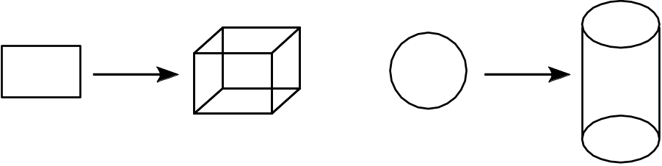
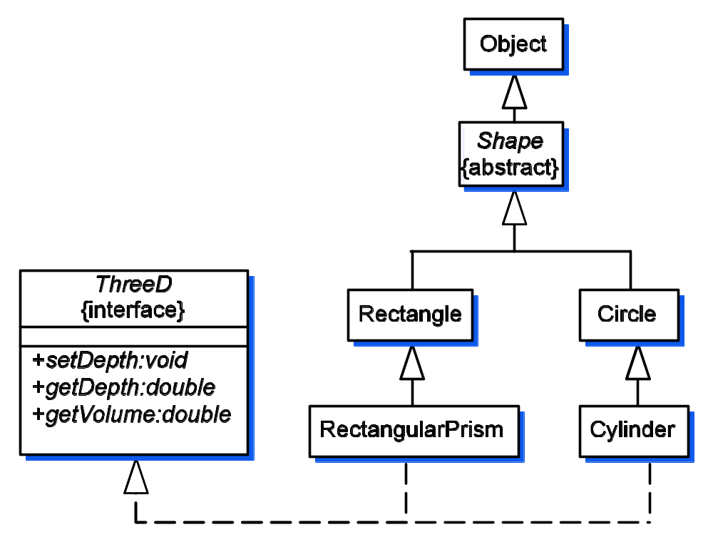
UML: Extends and Implements
Extending 2D shapes to 3D shapes
_{extends}
UML inheritance diagram –
The dotted line indicates a
class implements an interface.
For example, Cylinder extends
Circle and implements ThreeD.
implements
_{See next slide}

Slide 34
Implements: What’s it look like in Java?
package gray.adts.shapes;
import java.io.*;
/**
* A <tt>RectangularPrism</tt> has three dimensions:
* length, height and depth.
*/
public final class RectangularPrism extends Rectangle
implements ThreeD {
private double depth;
. . . // lots of other good stuff
}

Slide 35
Polymorphism with Shapes
// Create a bunch of different kinds of shapes
Rectangle rectangle = new Rectangle( 3.4, 4.5 );
Circle circle = new Circle(4.2);
RectangularPrism rectPrism = new RectangularPrism( 5.3, 6.6, 7.2 );
Cylinder cylinder = new Cylinder(3.5, 19.5 );
// Create an array to store any object that “is a kind of” Shape
Shape []bunchOshapes = new Shape[4];
String output = "\n";
// populate the array of shapes with the shape objectss
bunchOshapes[0] = rectangle; bunchOshapes[1] = circle;
bunchOshapes[2] = rectPrism; bunchOshapes[3] = cylinder;
for ( int i = 0; i < bunchOshapes.length; i++ ) {
output += bunchOshapes[i].toString() + "\n";
output += "\tsurface area = " + prec3.format(bunchOshapes[i].getSurfaceArea()); output += "\n\tperimeter = " + prec3.format(bunchOshapes[i].getPerimeter())
+ "\n\n";;
}
Dynamic binding – the runtime system will determine what kind of shape is being referenced for each bunchOShapes[i].method() and invoke the corresponding method for that kind of object.

Slide 36
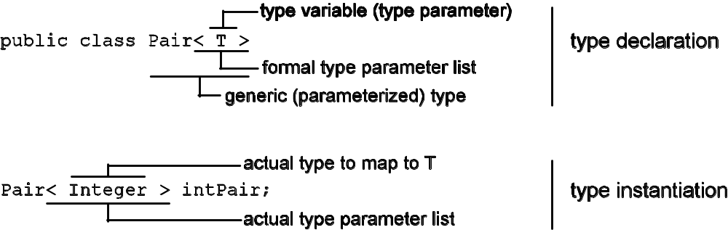
Generic Types in Java
Format for a generic (parameterized) type and instantiation
of a generic type

Slide 37
Using the Pair<T> class
/**
* Illustrate the use of a generic type.
*/
public class GenericsEx {
public static void main ( String args[] ) {
Pair<String> stringPair = new Pair<String>( "string", "Pair" );
Pair<Integer> intPair = new Pair<Integer>( 1, 2 );
System.out.println( "intPair is: " + intPair );
System.out.println( "stringPair is: " + stringPair );
intPair.swapElements();
System.out.println("\nAfter swapping elements, intPair is " + intPair);
intPair.setFirstElement( new Integer( -1 ) );
stringPair.setSecondElement( "Generic types are useful" );
System.out.println( "\nThe pairs after some resetting: " );
System.out.println( "\tintPair is: " + intPair );
System.out.println( "\tstringPair is: " + stringPair );
Integer intElement1 = intPair.getFirstElement();
String stringElement1 = stringPair.getFirstElement();
System.out.println( "\nintElement1 is " + intElement1 +
" and stringElement1 is " + stringElement1 );
}
}
Specifying the type parameter
stringPair can store a pair of String objects
intPair can store a pair of Integer objects
_{Program Output:}
intPair is: < 1, 2 >
stringPair is: < string, Pair >
After swapping elements, intPair is < 2, 1 >
The pairs after some resetting:
intPair is: < -1, 1 >
stringPair is: < string, Generic types are useful >
intElement1 is -1 and stringElement1 is string

Slide 38
The Pair<T> Class
/**
* A pair consists of two elements of the same type, specified by type parameter T.
*/
public class Pair<T> {
private T firstElement;
private T secondElement;
/**
* Construct an instance of a <tt>Pair</tt> initialized to the given elements.
* @param e1 the first element of this pair
* @param e2 the second element of this pair
* @throws NullPointerException if either <tt>e1</tt> or <tt>e2</tt> is <tt>null</tt>.
*/
public Pair( T e1, T e2 ) {
if ( ( e1 == null ) || ( e2 == null ) ) throw new NullPointerException();
this.firstElement = e1;
this.secondElement = e2;
}
/**
* Return the value of the first element of this pair.
* @return the first element of this pair
*/
public T getFirstElement() {
return this.firstElement;
}
/**
* Swap the two elements.
*/
public void swapElements() {
T temp = this.firstElement;
this.firstElement = this.secondElement;
this.secondElement = temp;
}
. . . // other stuff
The generic type T can be use to declare the type of
• class variables,
• parameters,
• return type
• local variables

Slide 39
Generic Types and Erasure
Erasure – the compiler will replace all occurrences in the class of type parameter with the upper bound of the formal type parameter
The default upper bound is the class Object

Slide 40
Generics & Erasure: The Generic Class
After erasure, the declaration Pair<Integer> intPair; would class definition
for Pair would look like this. Note that the places where T appeared have been
replaced with Integer’s upper bound, Object.
/**
* A pair consists of two elements of the same type. This class illustrates the
* definition of a generic type with type parameter <tt>T</tt>.
*/
public class Pair {
private Object firstElement;
private Object secondElement;
/**
* Construct an instance of a <tt>Pair</tt> initialized to the given elements.
* @param e1 the first element of this pair
* @param e2 the second element of this pair
* @throws NullPointerException if either <tt>e1</tt> or <tt>e2</tt> is <tt>null</tt>.
*/
public Pair( Object e1, Object e2 ){
if ( ( e1 == null ) || ( e2 == null ) )
throw new NullPointerException();
this.firstElement = e1;
this.secondElement = e2;
}
. . . // more stuff goes here

Slide 41
Generic & Erasure: The Client Class
/**
* Illustrate use of a generic type. The client class after erasure.
*/
public class GenericsEx {
public static void main ( String args[] ) {
Pair stringPair = new Pair( "string", "Pair" );
Pair intPair = new Pair( 1, 2 );
System.out.println( "intPair is: " + intPair );
System.out.println( "stringPair is: " + stringPair );
intPair.swapElements();
System.out.println("\nAfter swapping elements, intPair is "
+ intPair);
intPair.setFirstElement( new Integer( -1 ) );
stringPair.setSecondElement( "Generic types are useful" );
System.out.println( "\nThe pairs after some resetting: " );
System.out.println( "\tintPair is: " + intPair );
System.out.println( "\tstringPair is: " + stringPair );
Integer intElement1 = (Integer)intPair.getFirstElement();
String stringElement1 = (String)stringPair.getFirstElement();
System.out.println( "\nintElement1 is " + intElement1 +
" and stringElement1 is " + stringElement1 );
}
}
All occurrences of the
formal type are removed
Remember, the compiler
takes care of doing erasure
Type casts are need to
convert the Object
references returned by
the get methods to their
respective types; the
compiler does this for
you!

